Slide 1

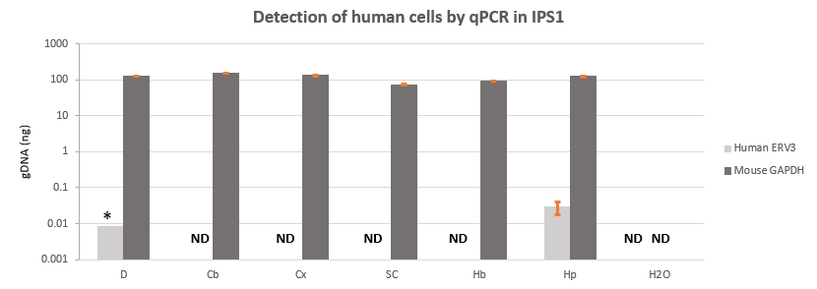
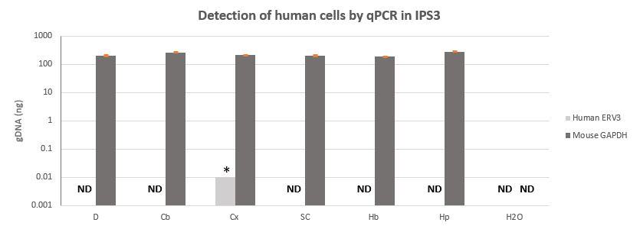
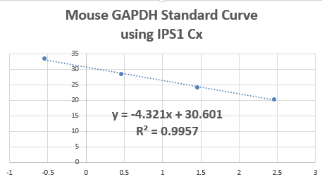
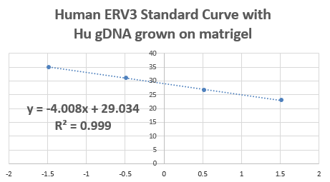
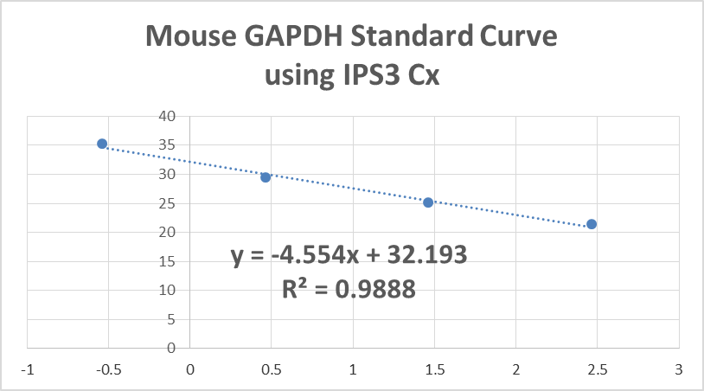
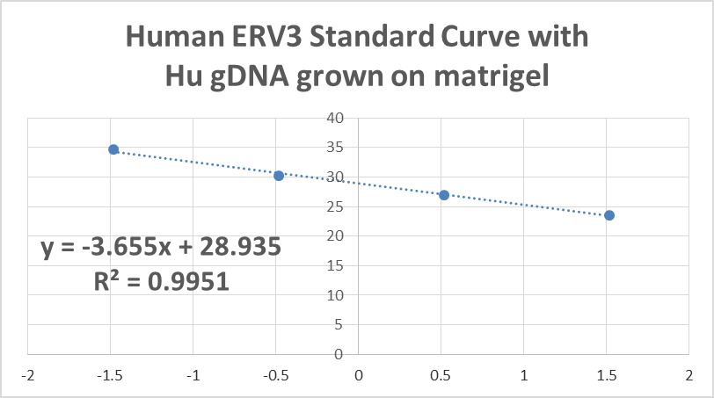
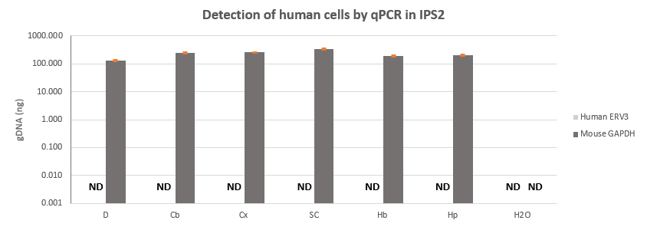
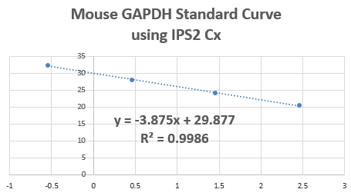
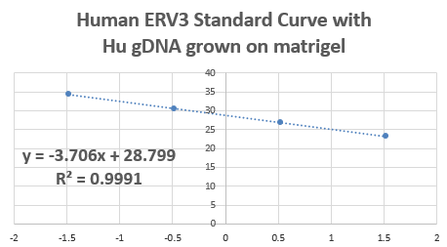
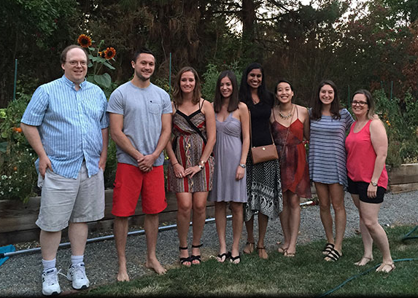
qPCR of Human ERV3 and Mouse GAPDH in mouse brains transplanted with human iPS cells
Catherine TK Le^{1,2}, Priyanka Somanath^{2,3}, Veronica Martinez-Cerdeno^{2,3}, Paul S Knoepfler^{1,2,3}
¹School of Medicine, Sacramento, CA ²University of California, UC Davis, Davis, CA
³Institute of Pediatric Regenerative Medicine in Shriners Hospitals for Children, Sacramento, CA
BACKGROUND
RESULTS
RESULTS
DISCUSSION
The clinical applications of human induced pluripotent stem cells (hIPSC) and human embryonic stem cells (hESC) are complicated by their capacity for tumorigenicity. Both hIPSC and hESC form teratoma derived from all three germ layers when injected into immunodeficient mice (1). However, the behavior of transplanted hIPSC and hESC in immunocompetent mice is less well understood.
Previous work in the Knoepfler Lab and Martinez-Cerdeno Lab revealed strong engraftment of both hESC and hIPSC by immunohistochemistry (IHC) staining in the cerebral cortex, olfactory bulbs, hippocampus, diencephalon, and spinal cord of immunocompetent mouse (unpublished data). Interestingly, no teratoma or pre-neoplastic lesion were observed 15 months post-transplantation (unpublished data).
To quantify the efficacy of human stem cell transplantation into murine tissue, we measured human genomic DNA as a surrogate for surviving transplanted hIPSC and their derivatives in different regions of the mouse brain in transplant recipients.
A
A
LIMITATIONS
The amount of detectable human gDNA was at the edge of detection for the assay; qPCR assay sensitivity may not have been sufficient to consistently capture true signal
Only portions of cortex, cerebellum, hindbrain, and diencephalon were used to extract gDNA and therefore the results may not represent the engraftment of the complete mouse brain
Mouse GAPDH, though a well-known housekeeper gene, has 331 pseudogenes reported in mice. Our designed primers fall within exon 7 of mouse GAPDH gene and has several pseudogene matches
CONCLUSIONS AND FUTURE DIRECTIONS
Hu ERV3 was consistently detectable in hippocampus of IPS1
Hu ERV3 was not consistently detectable in IPS2 or IPS3
qPCR couldn’t detect robust engraftment of hIPSC; however, the assay is able to detect the presence human gDNA in the mouse brain.
In the future, this model can potentially be used to compare effective transplantation among regions of the brain and tease out modulating factors that will increase or decrease stem cell transplantation success. However, qPCR assay may be best used at longer time points of tissue collection when hIPSC are given more time for migration, differentiation, and integration.
B
C
B
C
Figure 1. qPCR of Human ERV-3 and Mouse GAPDH in IPS1.
A: Human gDNA and mouse gDNA detected per region: Diencephalon, Cerebellum, Cortex, Spinal Cord, Hindbrain, and Hippocampus (left to right). Human gDNA was found in all 3 replicates of Hippocampus, approximately 4 human cells out of 38233 mouse cells (0.01%) [Mean + STDV: 0.029 + 0.011]. *Indicates only 1 of 3 replicates had detectable gDNA. ND: Not Detected.
B: Standard Curve of known loaded amounts of mouse gDNA. Primer efficiency of Mouse GAPDH is 70.83%.
C: Standard Curve of known loaded amounts of human gDNA. Human ERV-3 primer efficiency is 77.62%.
Figure 3. qPCR of Human ERV-3 and Mouse GAPDH in IPS3.
A: Human gDNA and mouse gDNA detected per region: Diencephalon, Cerebellum, Cortex, Spinal Cord, Hindbrain, and Hippocampus (left to right). *Indicates only 1 of 3 replicates had detectable gDNA. ND: Not Detected.
B: Standard Curve of known loaded amounts of mouse gDNA. Mouse GAPDH primer efficiency 65.80%.
C: Standard Curve of known loaded amounts of human gDNA. Human ERV-3 primer efficiency is 87.76%.
MATERIALS AND METHODS
REFERENCES
A
hIPSC production: Derived from parental human dermal fibroblasts transduced with retroviral particles containing pMXs vectors with human POU5F1, SOX2, KLF4, and MYC
hIPSC cell transplantation: Injected 200,000-250,000 hIPS cells into right lateral ventricle of 3 mice (IPS1, IPS2, and IPS3). Brain tissue collected 2-3 weeks post-transplant.
gDNA extraction: Whole sections or partial sections were used for gDNA extraction to obtain equal amounts of tissue per region: 1/2 of Diencephalon, 1/2 of Cerebellum, 1/6 of Cortex, 1/2 of Hindbrain, all of Hippocampus, and all of Spinal Cord. Tissues were lysed in tail digestion buffer and proteinase K, and gDNA was isolated by ethanol precipitation protocol. Control for study was Human gDNA from hESC grown on matrigel
qPCR protocol: 45 amplification cycles with ABsolute Blue and 250 ng of loaded gDNA samples.
Human ERV-3 primers: Forward: CAT GGG AAG CAA GGG AAC TAA TG Reverse: CCC AGC GAG CAA TAC AGA ATT T
Mouse GAPDH primers: Forward: ACC ACG AGA AAT ATG ACA ACT CA, Reverse: CCC ACT GCC TAC ATA CCA TGA GC
Calculation of the quantity of DNA in a cell
Mouse genome (haploid): 2.7 x 10⁹ bp, 1 copy of haploid = 2.9pg
Human genome (haploid): 3.4 x 10 bp, 1 copy of haploid = 3.3pg
50,000 cells = 330 ng human DNA or 290 ng mouse DNA
% of human cells = # of Hu cells / (# of Mo cells + # of Hu cells) x 100
(1) Knoepfler PS. Deconstructing stem cell tumorigenicity: a roadmap to safe regenerative medicine. Stem Cells. 2009 May;27(5):1050-6.
(2) Yuan CC, Miley Wendell, and Waters D. A quantification of human cells using an ERV-3 real time PCR assay. Journal of Vitrological Methods. 2001, 91: 109-117.
(3) Liu YJ, Zheng D, Balasubramanian S, Carriero N, Khurana E, Robilotto R, and Gerstein MB. Comprehensive analysis of pseudogenes of glycolytic enzymes in vertebrates: the anomalously high number of GAPDH pseudogenes highlights a recent burst of retrotrans-positional activity. BMC Genomics. 2009, 10:480
OBJECTIVES
Quantify engraftment of hIPSC transplanted in immunocompetent mouse brains in Cortex, Hippocampus, Diencephalon, Hindbrain, Cerebellum, and Spinal Cord
Apply quantitative polymerase chain reaction (qPCR) assay to detect the presence of human endogenous retrovirus 3 (ERV-3) and mouse glyceraldehyde-3-phosphate dehydrogenase (GADPH) in the mouse brain transplanted with hIPSC (2,3).
B
C
ACKNOWLEDGEMENTS
This study was made possible by the First Lady Helen Lemieux Internship Award from the Shriners Hospitals for Children in Northern California.
We would like to extend our sincere gratitude to other lab members of the Knoepfler Lab for their scientific insight and advice. I would also like to thank Dr. Saul Schaefer, Director of PSTP program, and Dr. David Pleasure, PSTP mentor.
Figure 2. qPCR of Human ERV-3 and Mouse GAPDH in IPS2.
A: Human gDNA and mouse gDNA detected per region: Diencephalon, Cerebellum, Cortex, Spinal Cord, Hindbrain, and Hippocampus (left to right). ND: Not Detected.
B: Standard Curve of known loaded amounts of mouse gDNA. Mouse GAPDH primer efficiency 81.16%.
C: Standard Curve of known loaded amounts of human gDNA. Human ERV-3 primer efficiency is 86.14%.

